Slide 1

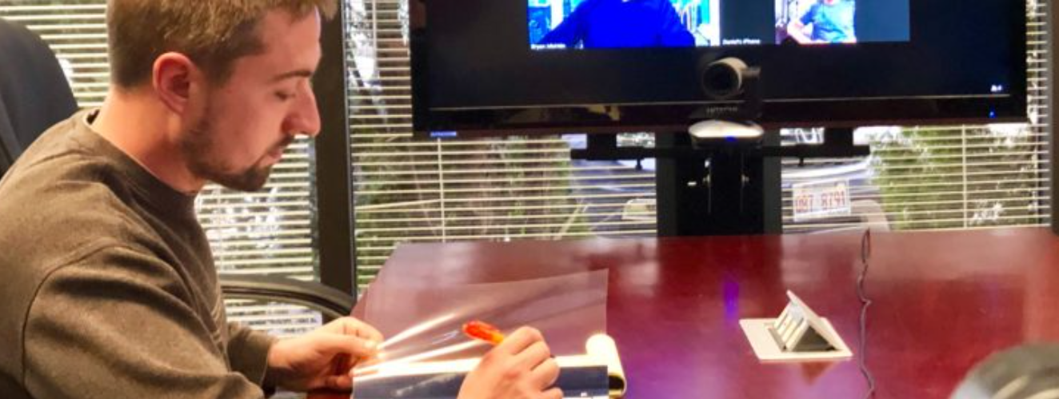
Using Zoom with a Telephone
Zoom name, Zoom icons, and examples of Zoom screens remain property of Zoom Video Communications, Inc and are used in this introductory video in accordance with their Acceptable Use Policy.

Slide 2
Using Zoom with a Telephone
Scenarios:
Audio-Only Meeting Using Smartphone or Conference Phone
Audiovisual Meeting Using Phone for Audio and PC or Laptop for Video
Switching Audio from PC or Laptop to Phone During a Meeting

Slide 3
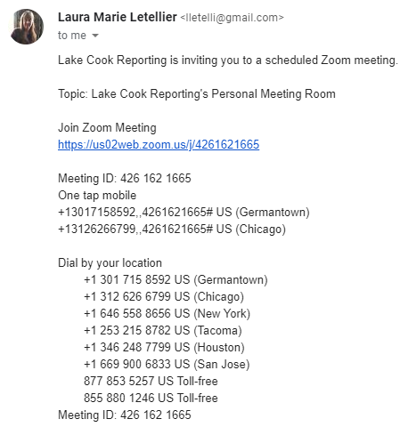

Audio-Only Meeting Using Smartphone or Conference Phone
Step 1 – Dial Into the meeting using your phone
Notes:
If administrator has enabled dial-in using one of the numbers shown. Note that one or more numbers may be toll-free

Slide 4
Audio-Only Meeting Using Smartphone or Conference Phone
Step 2 – When prompted, enter Meeting ID then press # Key
Notes:
Dial-in and when prompted, enter the 10-digit Meeting ID then press the # sign

Slide 5
Audio-Only Meeting Using Smartphone or Conference Phone
Step 3 – If prompted, enter Password the press # Key
Notes:
If prompted for this, enter a Password and press the # sign

Slide 6
Audio-Only Meeting Using Smartphone or Conference Phone
Step 4 – When prompted for Participant ID, press # Key to bypass
Notes:
When prompted for Participant ID, press the # sign to bypass this entry

Slide 7
Audio-Only Meeting Using Smartphone or Conference Phone
End of Scenario – Please stand by for Lake-Cook meeting administrator to admit you to the proceeding
Notes:
Please then standby for the Lake-Cook administrator to admit you. Note that this step may be immediate or may be several minutes, depending on how close to the meeting start time you dial-in

Slide 8
Audiovisual Meeting Using Phone for Audio and PC or Laptop for Video
Step 1 – Join the meeting using the web link
Notes:
Join the meeting using the web link.

Slide 9
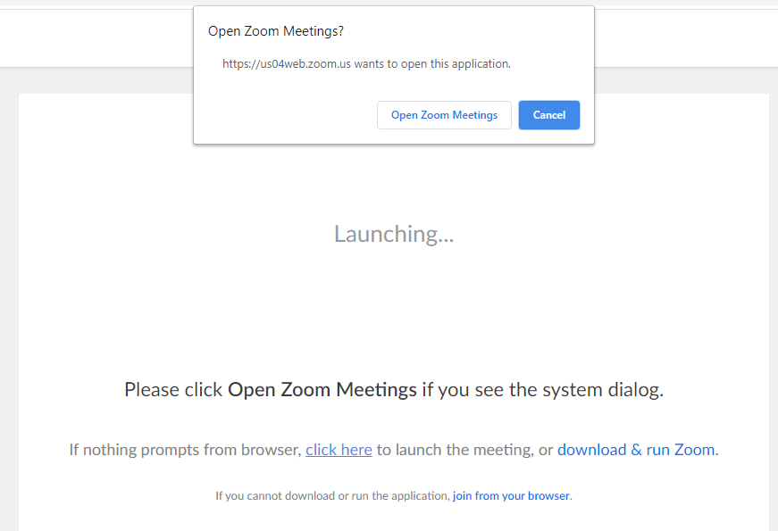
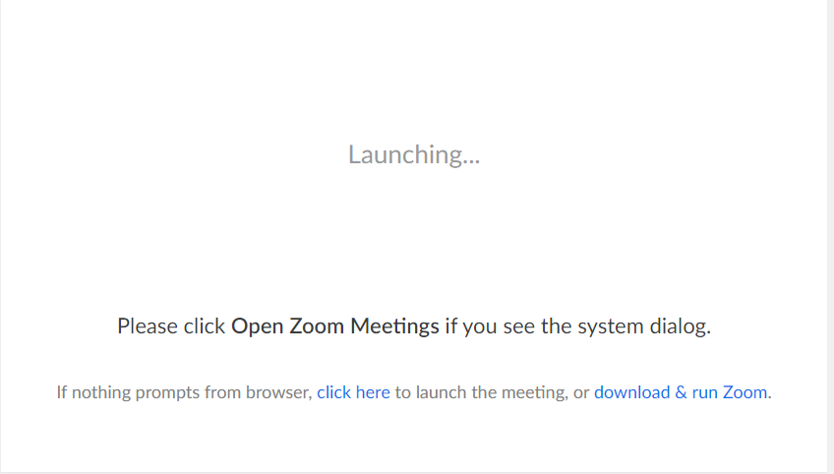
Audiovisual Meeting Using Phone for Audio and PC or Laptop for Video
Step 2 – Open the Zoom meeting
Notes:
Click on the “Open Zoom Meetings” button.
This step presumes that you have previously downloaded and installed the Zoom application. If not, please see the Lake-Cook video entitled: “Getting Started with Zoom”.

Slide 10
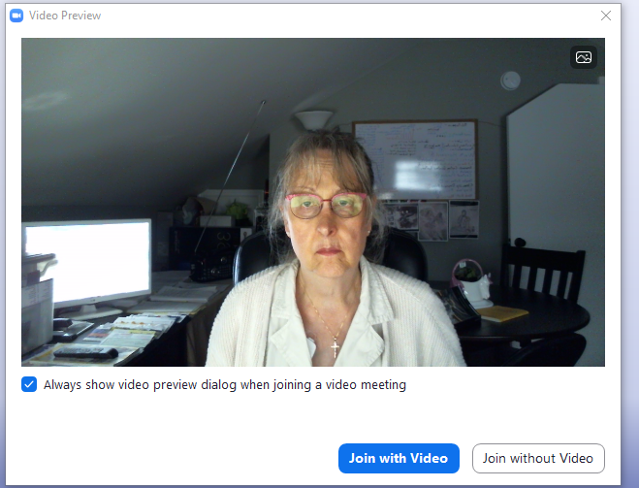


Audiovisual Meeting Using Phone for Audio and PC or Laptop for Video
Step 3 – Join with video
Notes:
Click on the “Join the Video” button

Slide 11
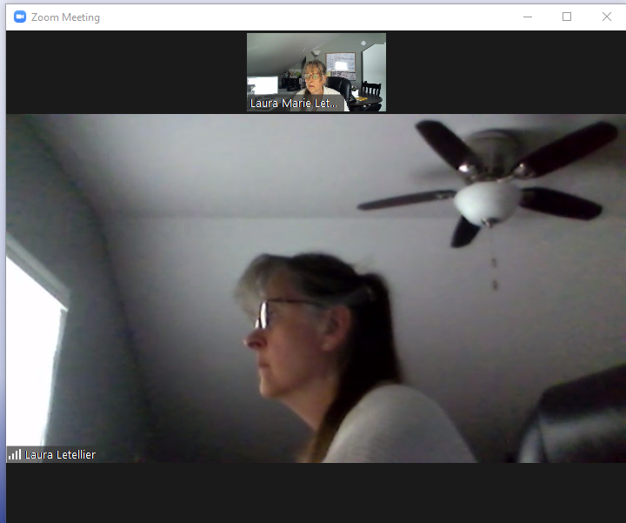

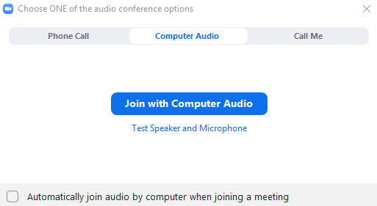
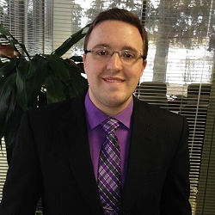
Audiovisual Meeting Using Phone for Audio and PC or Laptop for Video
Step 4 – Select Phone Call for Audio
Deponent #1
Mr. Letellier
Notes:
If your Lake-Cook administrator has enabled dial-in for audio, this screen will appear. Click the “Phone Call” option to proceed.

Slide 12
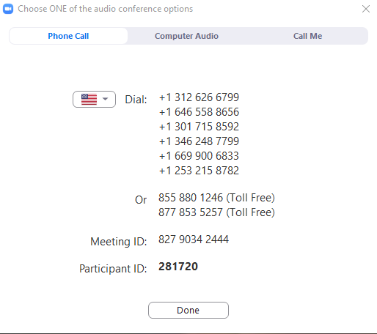
Audiovisual Meeting Using Phone for Audio and PC or Laptop for Video
Step 5 – Dial Into the meeting using your phone
Deponent #1
Mr. Letellier
Notes:
Dial-in using one of the numbers shown. Note that one or more numbers may be toll-free

Slide 13
Audiovisual Meeting Using Phone for Audio and PC or Laptop for Video
Step 6 – When prompted, enter Meeting ID then press # Key
Deponent #1
Mr. Letellier
Notes:
When prompted, enter the 10-digit Meeting ID then press the # key

Slide 14
Audiovisual Meeting Using Phone for Audio and PC or Laptop for Video
Step 7 – If prompted, enter Password the press # Key
Deponent #1
Mr. Letellier
Notes:
If prompted for this, enter a Password and press the # key

Slide 15
Audiovisual Meeting Using Phone for Audio and PC or Laptop for Video
Step 8 – When prompted, enter the Participant ID then press the # Key
Deponent #1
Mr. Letellier
Notes:
Then when prompted, enter the Participant ID and then press the # key

Slide 16
Audiovisual Meeting Using Phone for Audio and PC or Laptop for Video
Step 9 – Click the Done button
Deponent #1
Mr. Letellier
Notes:
Then click the “Done” button to dismiss this screen

Slide 17
Audiovisual Meeting Using Phone for Audio and PC or Laptop for Video
End of Scenario – Please stand by for Lake-Cook meeting administrator to admit you to the proceeding
Notes:
Please then standby for the Lake-Cook administrator to admit you. Note that this step may be immediate or may be several minutes, depending on how close to the meeting start time you dial-in. This scenario is completed.

Slide 18
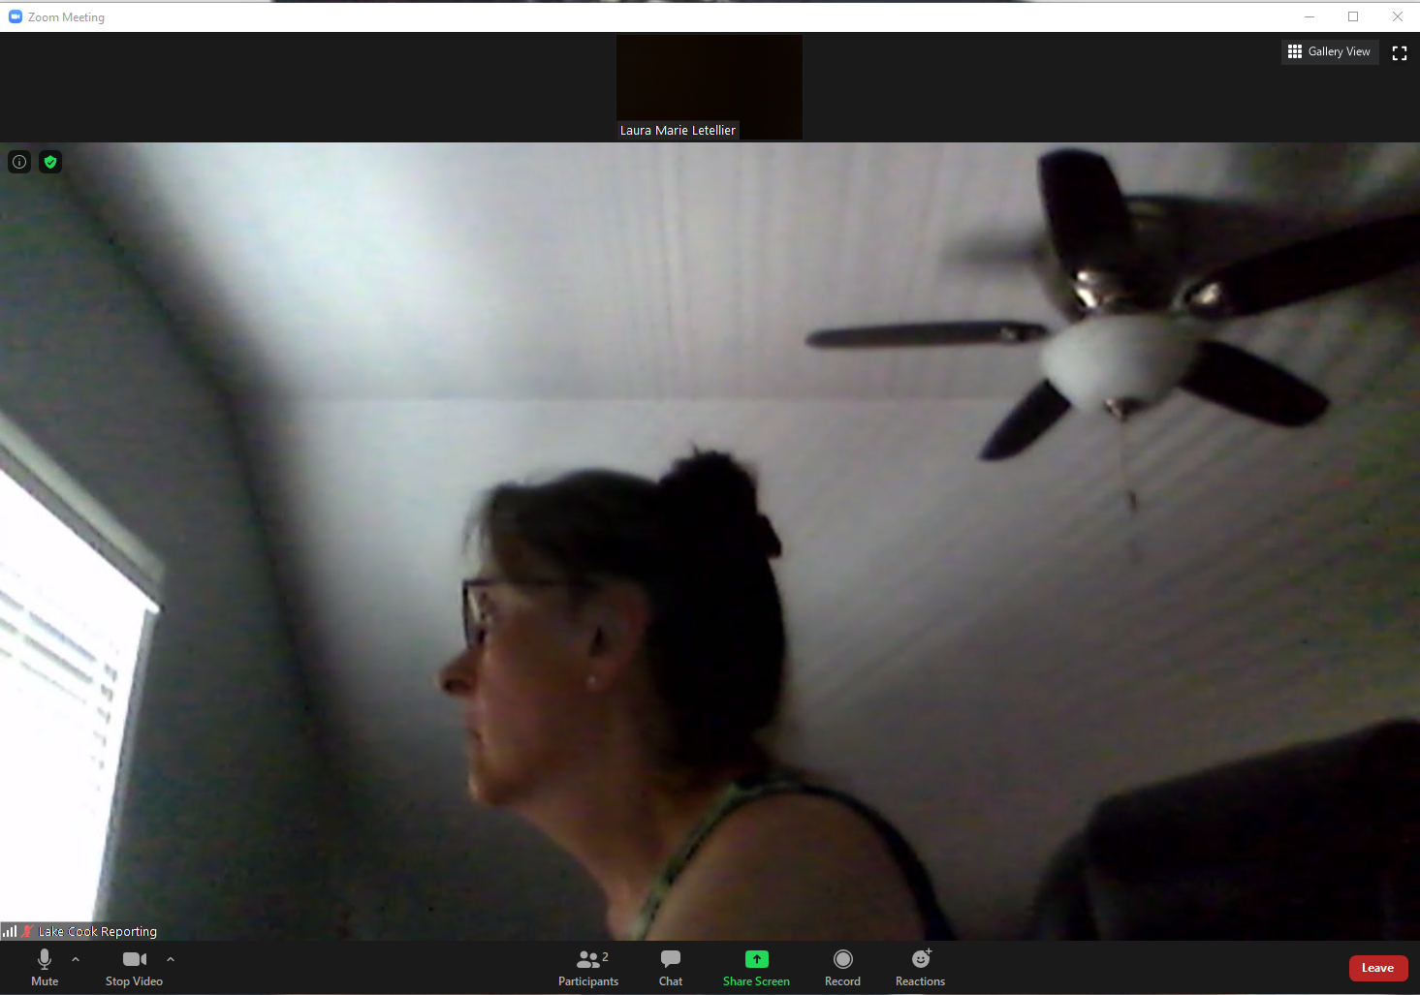
Switching Audio from PC or Laptop to Phone During a Meeting
Step 1 – Look for the microphone in the lower left of your screen
Deponent #1
Mr. Letellier
Notes:
Look for the microphone icon in the lower left corner of your screen

Slide 19
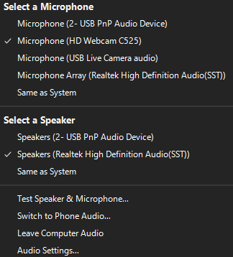
Switching Audio from PC or Laptop to Phone During a Meeting
Step 2 – Click on the caret (^) symbol just to the right of it
Deponent #1
Mr. Letellier
Notes:
Click on the caret (^) symbol just to the right of it to display the audio options menu

Slide 20
Step 3 – Then click on the option that reads: “Switch to Phone Audio”
Switching Audio from PC or Laptop to Phone During a Meeting
t
Deponent #1
Mr. Letellier
Notes:
When this screen appears, click on the line that reads: “Switch to Phone Audio”

Slide 21
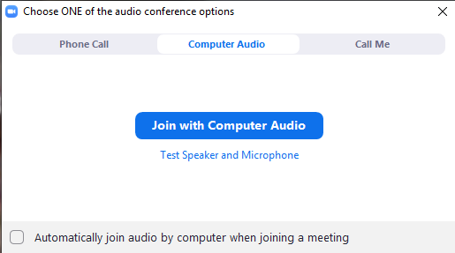
Switching Audio from PC or Laptop to Phone During a Meeting
Step 4 – Dial Into the meeting using your phone
Deponent #1
Mr. Letellier
Notes:
If your Lake-Cook administrator has enabled dial-in for audio, this screen will appear. Click the “Phone Call” option to proceed.

Slide 22
Switching Audio from PC or Laptop to Phone During a Meeting
Step 5 – Dial in and when prompted, enter Meeting ID then press # Key
Deponent #1
Mr. Letellier
Notes:
Dial-into the meeting using one of the numbers provided, then when prompted, enter the 10-digit Meeting ID then press the # key

Slide 23
Switching Audio from PC or Laptop to Phone During a Meeting
Step 6 – If prompted, enter Password the press # Key
Deponent #1
Mr. Letellier
Notes:
If prompted for this, enter a Password and press the # key

Slide 24
Switching Audio from PC or Laptop to Phone During a Meeting
Step 7 – When prompted, enter the Participant ID then press the # Key
Deponent #1
Mr. Letellier
Notes:
Then when prompted, enter the Participant ID and then press the # key

Slide 25
Switching Audio from PC or Laptop to Phone During a Meeting
Step 8 – Click the Done button
Deponent #1
Mr. Letellier
Notes:
Then click the “Done” button to dismiss this screen

Slide 26
Switching Audio from PC or Laptop to Phone During a Meeting
End of Scenario – You are now using your phone for audio
Notes:
You are now using your phone for the audio portion of the meeting. This scenario is completed.

Slide 27
Using Zoom with a Telephone
Tips:
When two or more people are speaking at once, only one will be heard
Please make sure each speaker is done before speaking
If you need to object, please visually signal to the other participants and speak clearly
When using your phone for audio, please ensure your laptop or PC audio is off
This will aid in creating a clean record
Notes:
Zoom will let one person speak at each time, so, when two people are speaking at once, only one will be heard by everyone else.
For this reason, make sure each speaker has finished speaking and anticipate there could be a 1-2 second delay periodically.
If you need to object, please raise your voice and speak clearly or signal to the other participants to make sure your objection is heard.
This will help to create a clean record and make sure each party is heard.

Slide 28
Using Zoom with a Telephone
Other Information:
If you have earbuds or headset with a microphone, we recommend using it -
Good options include EarPods for iPhone or the Android headset
If you have an unreliable Internet connection, we recommend joining by phone
If your connection is intermittent, we may ask you to switch to phone
When using your phone for audio, please ensure your laptop or PC audio is off
Notes:
If you have earbuds or headset with a microphone, we recommend using it - good options include EarPods for iPhone or the Android headset
If your computer audio is insufficient, or your internet connection is slow, we recommend joining by phone.
If a participant’s audio begins to cut in and out, we will ask that participant to please switch to a Smartphone or Conference Phone for audio
If dialing in by phone, please turn off your laptop or PC microphone and speakers to prevent echoing

Slide 29
Using Zoom with a Telephone
Finally:
If you do not feel comfortable with Zoom, we can help
  We will assist you in setting up Zoom
  If you prefer, our offices with high definition videoconferencing systems are open
  We maintain distancing and good cleaning practices
Please contact Greg for IT support at (847) 236-0773
Notes:
If you do not feel comfortable working with Zoom or would feel more comfortable having us handle it on your behalf, we can help.
We will assist you in setting up Zoom
If you prefer, we are still welcoming clients to our office and our high definition videoconferencing systems are still open
At our offices, we are asking that each party maintain a recommended safe distance from one another.
We have placed barriers in our conference rooms between participants
We are taking steps to sanitize all rooms, surfaces, and equipment before and after meetings.
The safety of our clients is our first priority and we are still offering the use of our executive conference space and professional video systems.
If you have any additional questions, please call Greg (IT Support) at (847) 236-0276

